Slide 1

TaiRox Collections
Don Thomson, CEO

Slide 2
Agenda
TaiRox Website Resources
Most Compelling Collections Benefits
Demonstration
Recent Feature Additions

Slide 3
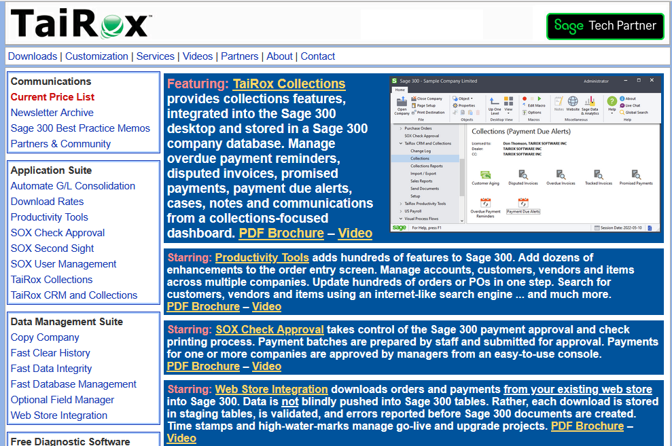
TaiRox Website
Up-to-Date
  Price List
  PDF Brochures
  Videos
  Memos
  Newsletters
  Downloads
  Release Notes
  Install Check

Slide 4
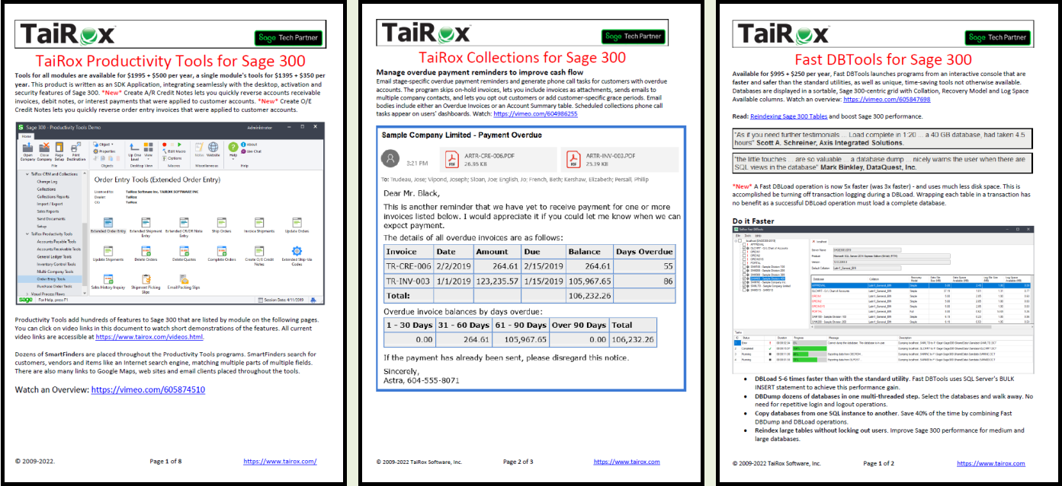
PDF Brochures with Embedded Videos

Slide 5
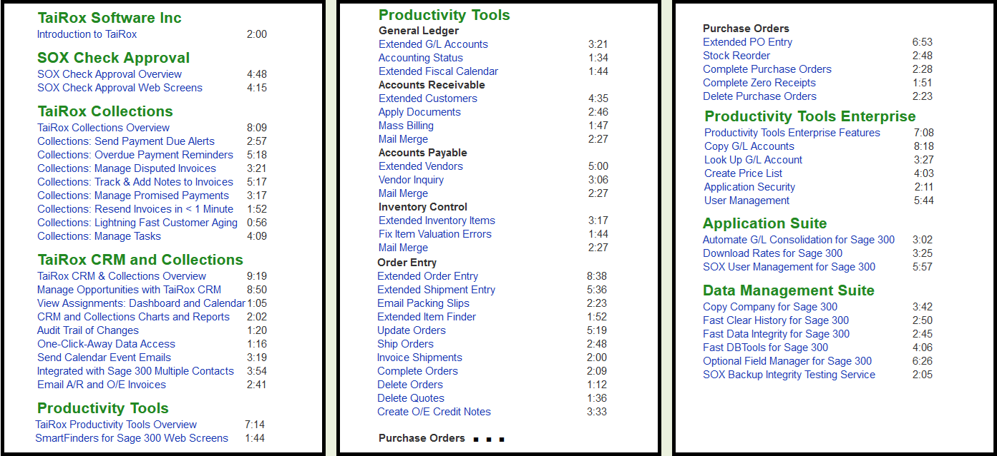
Videos Page

Slide 6
Memos: Sage 300 Technical Details

Slide 7
Most Compelling Collections Benefits
Primary Benefits
  Sending Overdue Payment Reminders
  Sending Invoices
  Send Documents to Chase Collections
  Viewing an Enhanced Aged Trial Balance
Secondary Benefits
  Sending Payment Due Alerts
  Tracking Promised Payments
  Tracking Disputed Invoices
  Assessing Collections Performance

Slide 8
Compelling Benefit Notes
Permanent Records
  An Overdue Invoice is a row in a table, not a transient state.
  An Overdue Payment Reminder is a row in a table.
  A Payment Due Alert is a row in a table
  A Communication is a row in a table.
Communications
  Are created automatically when emails are sent
  Link an EML file to a customer or a national account

Slide 9
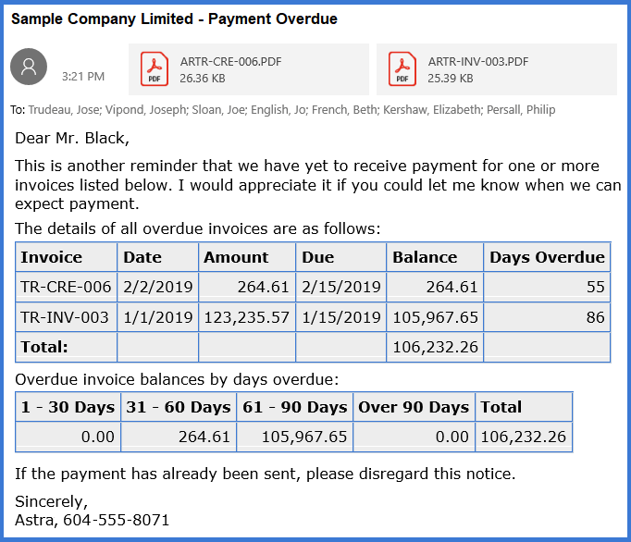
EML File Displayed in an Email Client

Slide 10
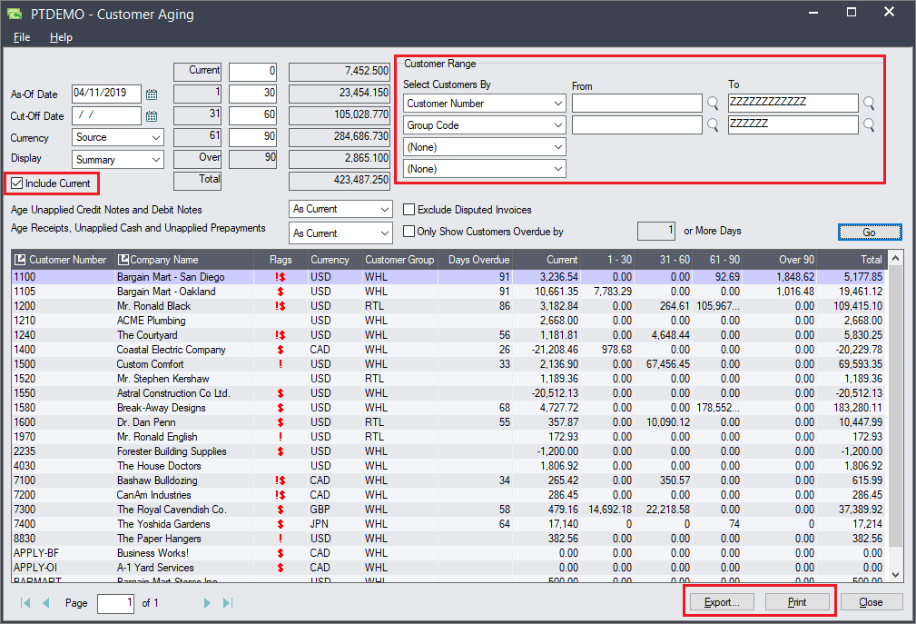
Customer Aging
Aged Trial Balance
  Fast
  Enhanced Display
  Filtering Options
  Export to Excel
  Print ATB

Slide 11
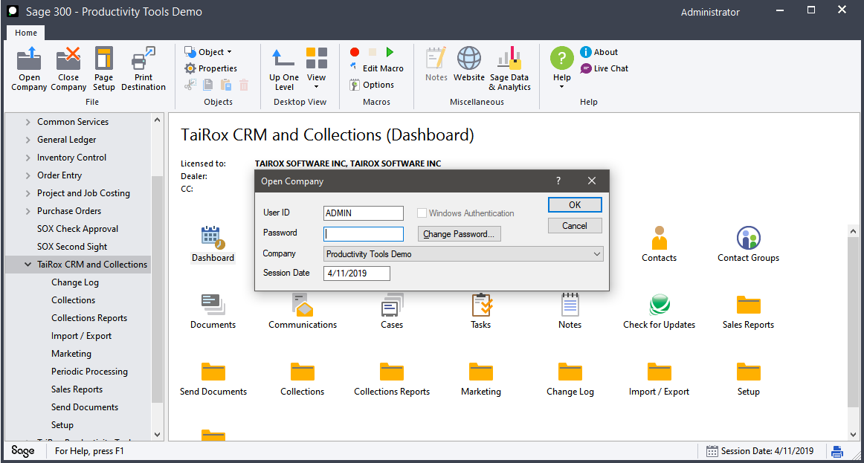
Demonstration
Log into SAMLTD on 4/11/2019

Slide 12
Recent Feature Additions
Scheduler Program
Collections Inquiry
National Accounts
Promised Payments linked to Invoices
Periodic Processing
Multi-Language Template Support

Slide 13
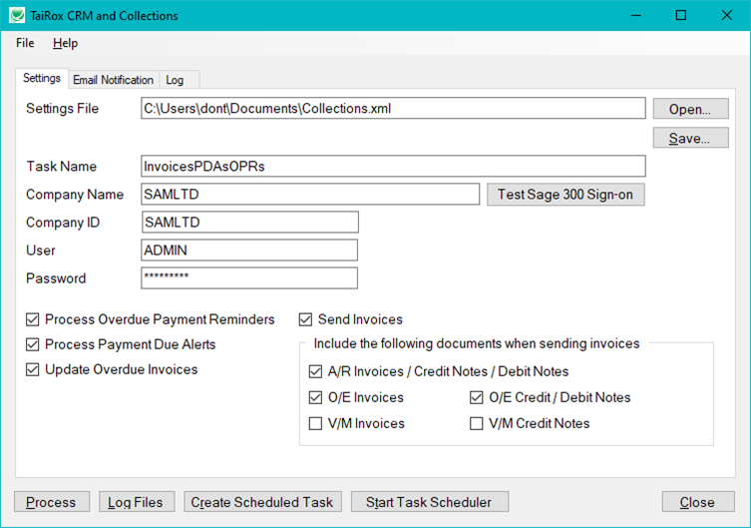
Scheduler Program
A Windows Scheduled Task
Sends "Unprinted" Invoices
Preferred Language Support

Slide 14
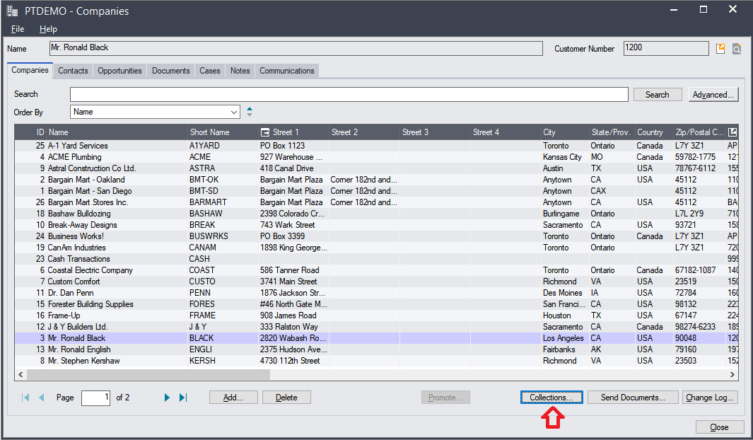
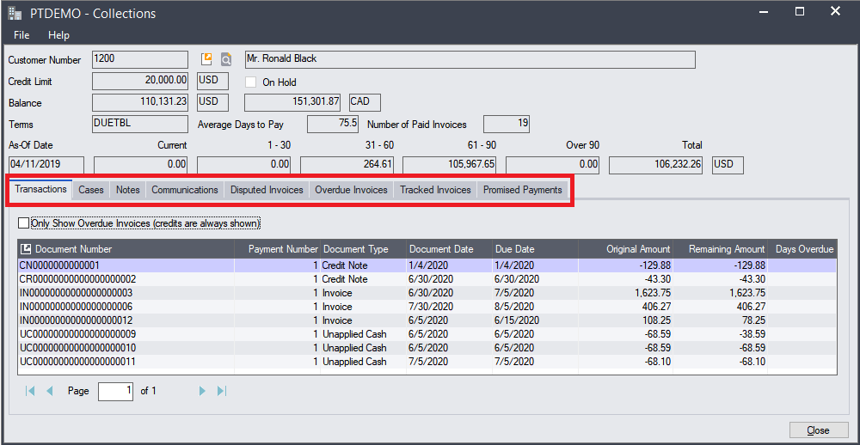
Collections Inquiry
Launch from Companies screen
All information related to collections – similar to customer inquiry

Slide 15
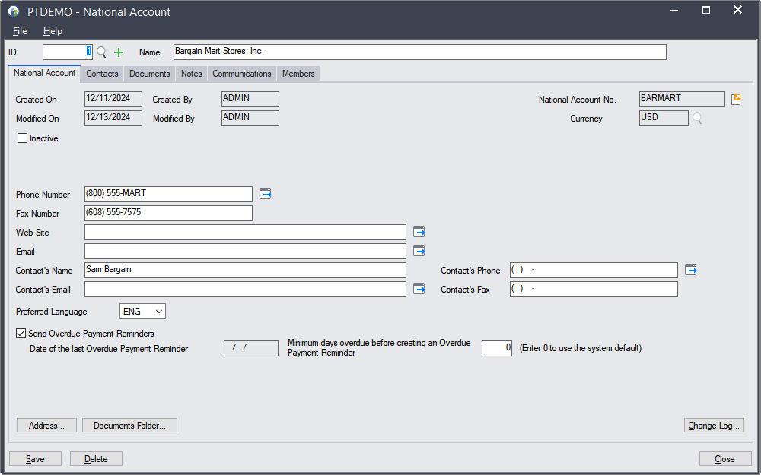
National Accounts

Slide 16
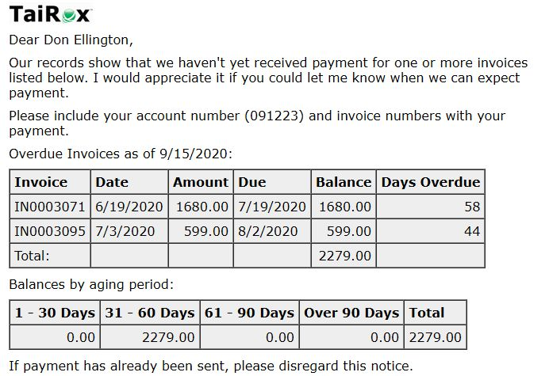
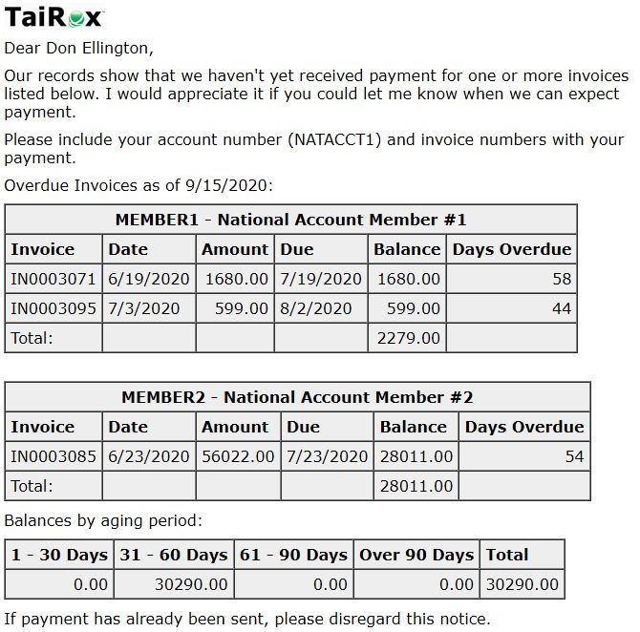
National Accounts
Customer Preview
National Account Preview

Slide 17
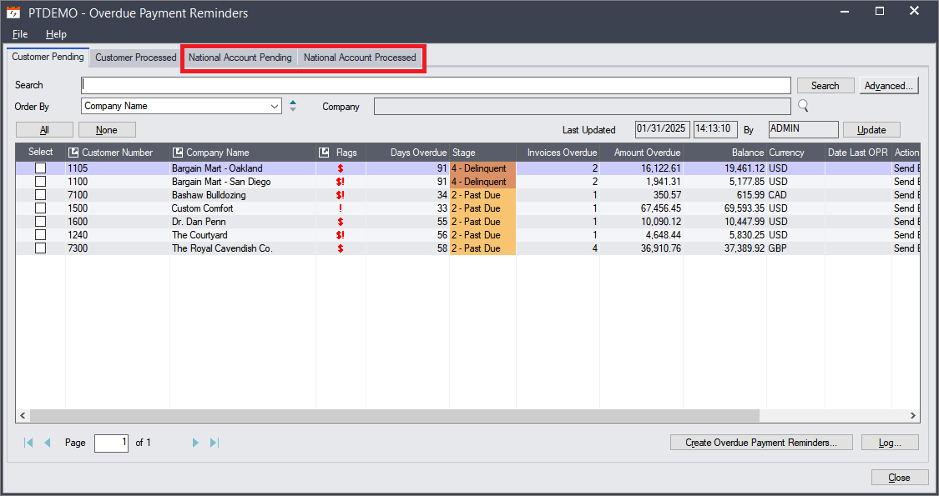
National Account Overdue Payment Reminders
Process either company or national account reminders

Slide 18
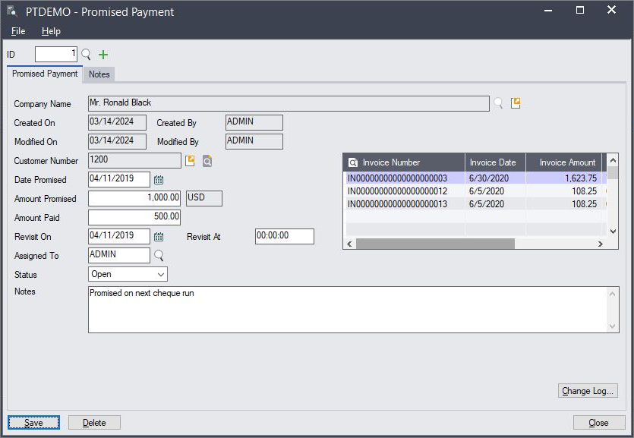
Promised Payments
Promised Payments
  Can now be linked to zero or more invoices

Slide 19
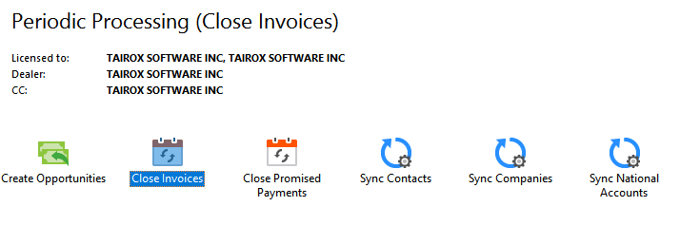
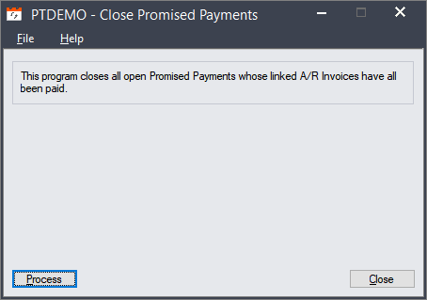
Periodic Processing
Close Invoices
  Closes tracked and disputed invoices that have been paid.
Close Promised Payments
  Closes promised payments whose linked A/R invoices have all been paid.

Slide 20

Multi-Language Template Support
Customer has a Preferred Language
French Templates are in a FRA sub-directory

Slide 21
Questions
?

